Slide 1

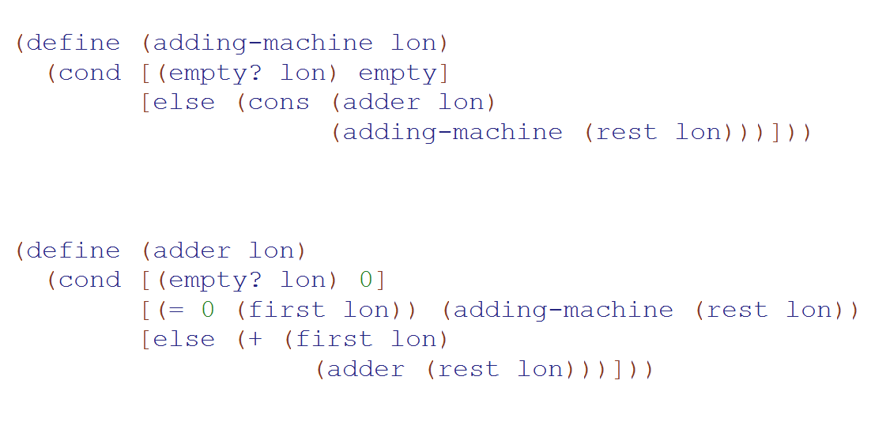
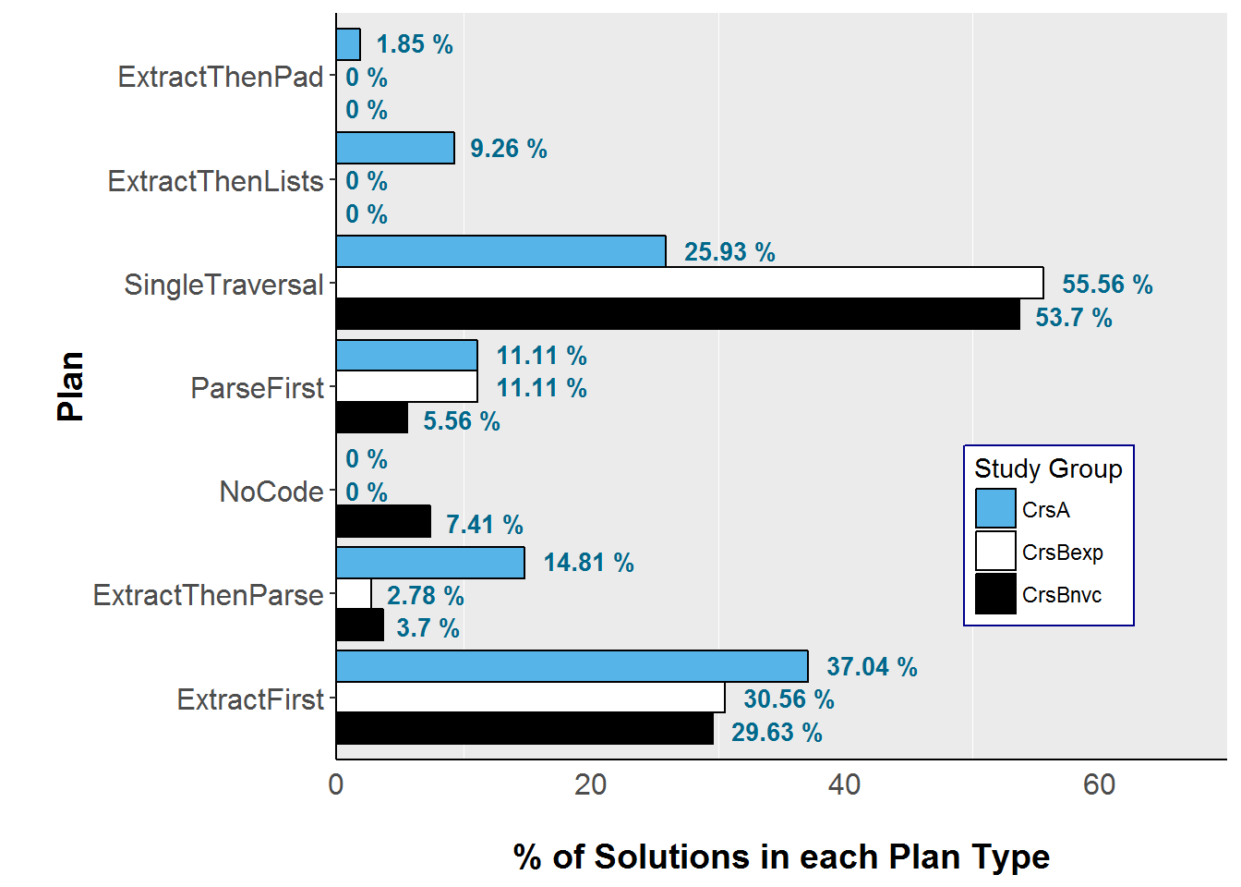









Developing Narratives on Students' Program Planning
Francisco Castro, fgcastro@cs.wpi.edu Advisor: Kathi Fisler, kfisler@cs.wpi.edu
WPI Computer Science
Observations from prior studies
User Study
Adding Machine – Input: [1, 2, 0, 7, 0, 5, 4, 1, 0, 0, 6] Output: [3, 7, 10]
Participants (N=13)
Reported prior experience
CS1
CS2
High school class (7)
Online course (3)
Self-study (4)
Boot camps/workshops (1)
Programming clubs (1)
AP class (3)
None (2)
Java (5)
Python (4)
C++ (3)
JavaScript (3)
PHP (2)
Racket (1)
Ruby (1)
build list
helper function
Exam 1 Grade | A (90-100) | B (80-89) | C (65-79) | Mean (grade)
Male | 3 | 2 | 1 | 87.67
Female | 3 | 1 | 3 | 82
# Students | 6 | 3 | 4 | 84.62
Mean (grade) | 93.67 | 85.67 | 70.25
single zero
Output: number
sum
Output:
list
Output: number
Students struggled to develop working solutions, decomposing the problem on-the-fly rather than planning ahead; they were unable to figure out how to adapt a familiar process to a more complex problem [1]
Course
Session activities
Time
Review homework solutions
Session no. & Activities
1
2
3
4
5
6
Compare/rank code solutions
Data Smoothing – Input: [95, 102, 98, 88, 105] Output: [95, 98.33, 96, 97, 105]
Write a code solution
Sketch a solution
Students were able to produce solutions for single-task problems after CS1
Many students struggled to write multiple-task programs, even after initial lectures on such problems
Qualitative Analysis
Taxonomic Mapping
Verbal protocols
(+ user artifacts)
Directed interviews and/or think-aloud protocols [3] are conducted in each session to elicit student responses, reflections, and insight into cognitive processes during task performance.
SOLO Category | Theme: Functions & Use of expressions [ Exemplars ]
Prestructural Lack of knowledge | So "or" isn't always the first thing I go to, just because I'm not too familiar with it.
Unistructural About a single expression | if the list is empty, then it should return zero, because the output should be a number
Multistructural About a series of expressions | And so if that's false, it goes onto the next one where it asks if it's cons, and if it's true, it goes on to see if the name that was given in the function matches the first list of strings – so the first ad, the name in there, if that's true, then it adds the air cost
Relational Interactions among multiple expressions | So, that list of ads is then acted on by this function, total-cost-for-aloa, which takes a list of ad. It […] produces a number, so this list that I've just created is now acted on by a function that takes a list and creates a number
What distinguishes those who can write multiple-task programs from those who can’t?
Verbal transcripts
Verbal protocols collected from each session are transcribed for analysis.
Key observation: Not all learners are able to make use of program design principles effectively, even after interventions directed at addressing how to adapt techniques to more complex contexts
Grounded theory methods [2] are adapted for coding verbal transcripts.
Coding involves attaching qualitative labels (codes) to data excerpts to identify themes, categories, and summaries for developing an emergent theory about the data.
Coded transcripts
Study Concept & Research Questions
Goals: Explore how students plan programs and the factors that influence their decisions; develop qualitative narratives about how students progress in programming and planning
Method: Conduct a series of interviews and think-aloud sessions with students through their first two CS courses and follow their progress throughout these courses
A semi-closed card sort is adapted to classify the codes using the SOLO taxonomy [4] and the emergent themes from the qualitative coding process.
Taxonomic mapping
SOLO: Structure of Observed Learning Outcomes
Research questions:
Describes five (5) levels of increasing complexity in understanding of a discipline or subject area; increasing complexity of connections
Development of knowledge: What factors and design principles do students draw on and use in their narratives of their programming processes?
Development of process: In what ways do students’ design choices evolve as they progress through their courses?
Management of learning: What metacognitive processes or strategies do students articulate in their narratives and in what ways do these interact with their programming processes?
References and Acknowledgement
Lack of Knowledge
Increasing Quantity of Knowledge
Increasing Depth of Knowledge
[1] F. Castro and K. Fisler. 2016. On the Interplay Between Bottom-Up and Datatype-Driven Program Design. SIGCSE ’16. ACM, 205–210.
[2] P. Kinnunen and B. Simon. 2012. Phenomenography and grounded theory as research methods in computing education research field. Computer Science Education 22, 2, 199–218.
[3] J. Nielsen, T. Clemmensen, and C. Yssing. 2002. Getting Access to What Goes on in People’s Heads?: Reflections on the Think-aloud Technique. NordiCHI ’02. ACM, 101–110.
[4] J. Whalley et al. 2006. An Australasian Study of Reading and Comprehension Skills in Novice Programmers, Using the Bloom and SOLO Taxonomies. ACE ’06.
We thank the students who participated in the study. This research is partially funded by the US NSF.
Icons were made by Freepik, Vectors Market from www.flaticon.com.
Prestructural
Unistructural
Relational
Multistructural
Extended Abstract

